Slide 1

Module 6 Final Project
By: Buddy Mrowka, John DiSessa, and Rachel Su

Slide 2
Flight Data Set Introduction
Made up of 29 different variables
Ex: day of the week, airline code, arrival delay time, plane tail number, flight distance, flight origin
Also contains details about canceled flights
Contains 7,709,385 observations worth of flight data
Each row includes details describing individual flights from 2019
Can be used to gain a wide variety of insights regarding flights

Slide 3
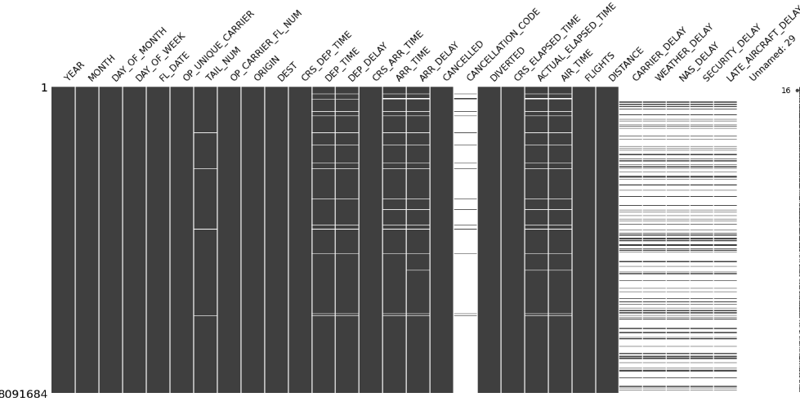
EDA: Understanding the Missing Data
Using the missingno Python library to identify and visualize missing data to get a sense of our dataset. The columns CANCELLATION_CODE , CARRIER_DELAY, WEATHER_DELAY, NAS_DELAY, SECURITY_DELAY, and LATE_AIRCRAFT_DELAY show large portions of missing data which make sense due to the flights that are operated without delay and cancellation are still the majority.

Slide 4
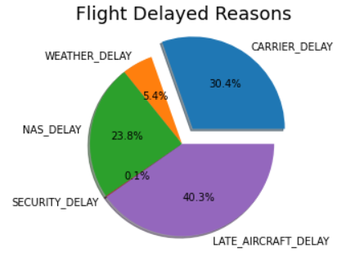
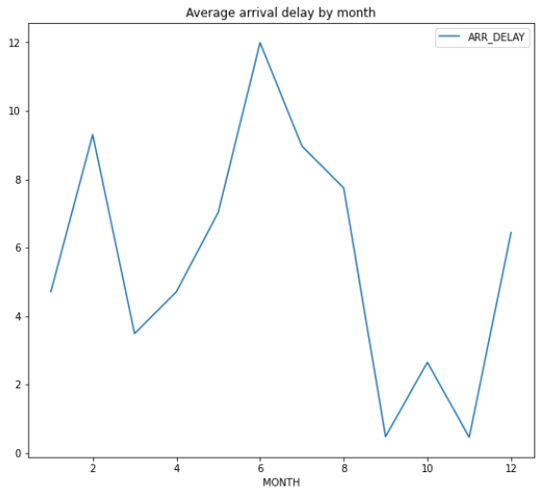
EDA: Delay Reasons and Monthly Frequency
The main reason cause the flight delayed is “late aircraft delayed” .It means the previous flight with same aircraft arrived late, causing the present flight to depart late.
Delays focused on February, June and December, with a peak on average delays in June 2019.

Slide 5
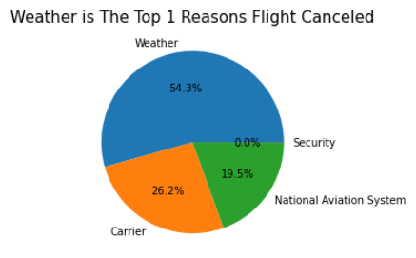
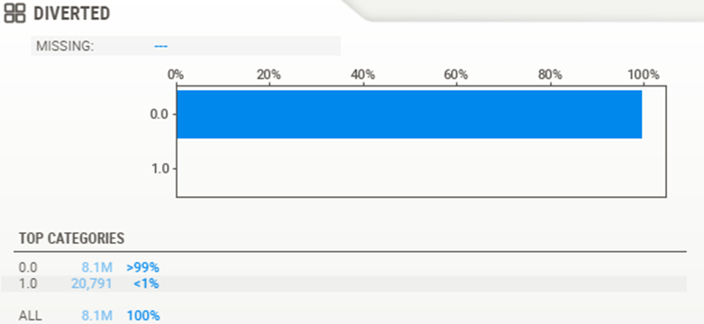
EDA: Cancellation Reasons and Diversion Ratio
Weather is the Top reason to cause flight cancellations. Followed by Carrie, National Aviation System and we have less than 1% of flight cancellations were due to security.
There are only less than 1 % of US domestic flights were diverted in 2019

Slide 6
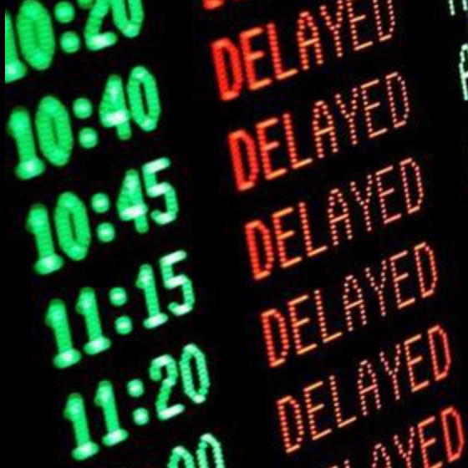
Real World Problem: How to Avoid Travel Problems
People across the globe depend on flying for all kinds of tasks
Delays/Cancellations therefore impact all kinds of tasks
Travelers cannot control whether a flight is delayed or not
Travelers can control:
The airports they fly out of/into
The airlines they choose to fly on
The days they travel on
Insights based on the three above areas will allow travelers to minimize their risk of experiencing travel problems

Slide 7
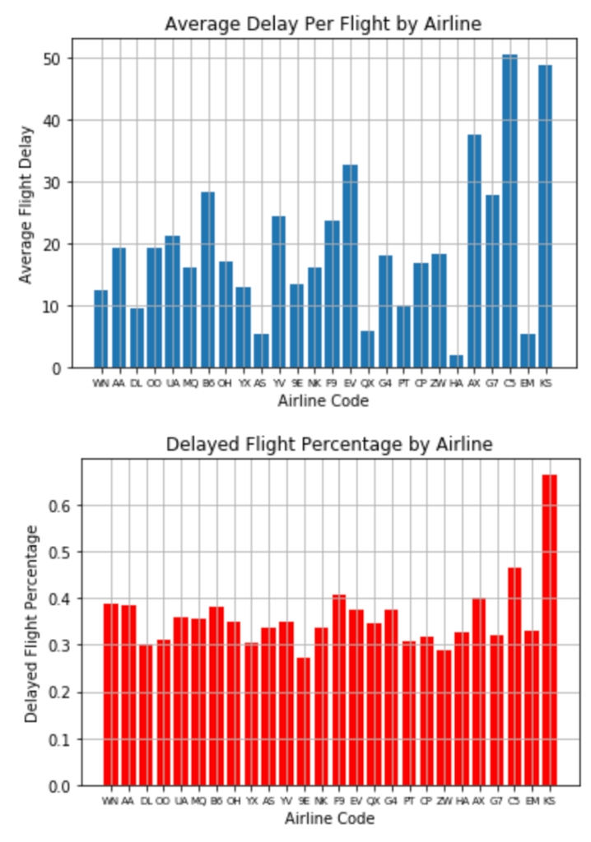
Focus Area 1: Airline Selection
To analyze the relationship between airlines and delay risk we studied two statistics:
Mean delay time per flight (top)
The following airlines had highest average delay per flight:
C5, KS, AX, and EV
Greater than 25 minutes per flight
Delayed flight percentage (bottom)
The following airlines had the greatest delay percentages:
KS, C5, and F9
A minimum delay rate of 40%

Slide 8
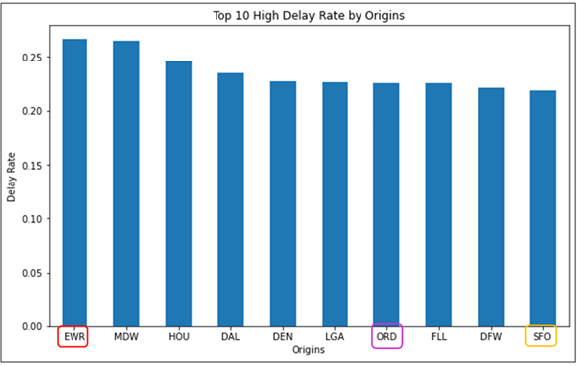
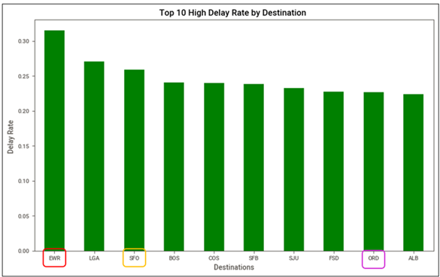
Focus Area 2: Delay Rate of Airports
The delayed rate of travel locations analysis give traveler a sense of how many chances their flight might be delayed from a certain airport they are traveling from or heading to.
Top 3 high delay rate by origin airports:
EWR
MDW
HOU
Top 3 high delay rate by destination airports:
EWR
LGA
SFO
EWR is on top one of both lists.

Slide 9
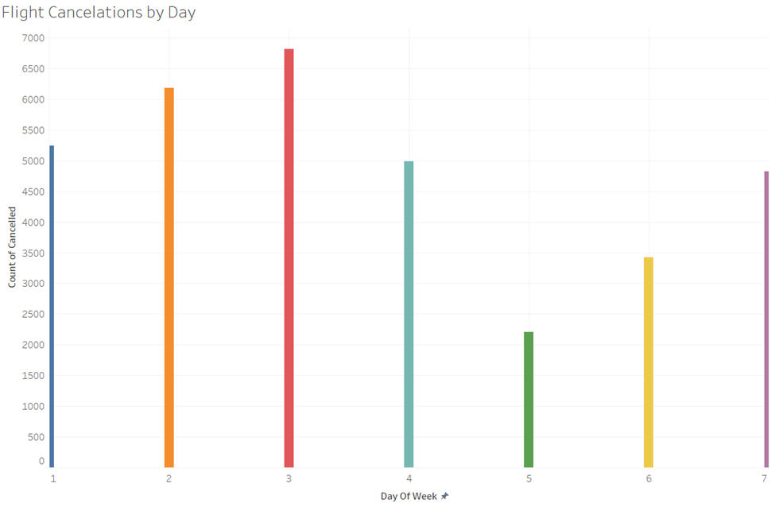
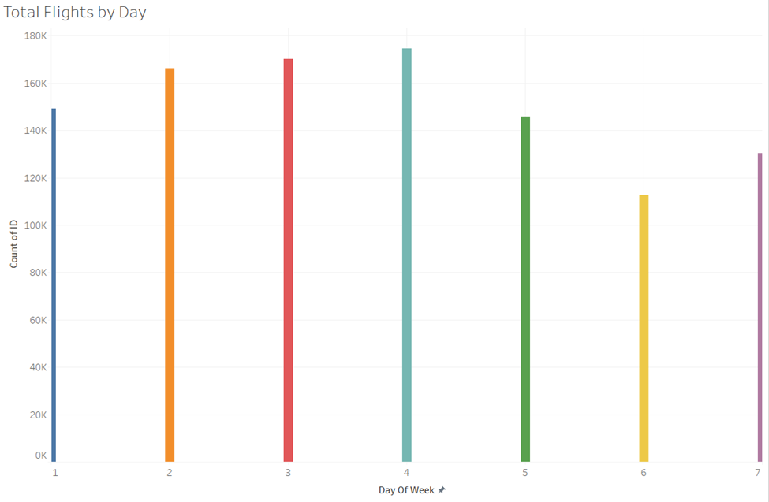
Focus Area 3: Travel Days of Week
Analyze flight cancellation rates by day of week
Monday - Sunday
Wednesday, Thursday, Friday most intriguing
Two-Sample t-test
Day of Week | Monday | Tuesday | Wednesday | Thursday | Friday | Saturday | Sunday
% Flights Canceled | 3.51% | 3.73% | 4.01% | 2.86% | 1.52% | 3.04% | 3.70%

Slide 10
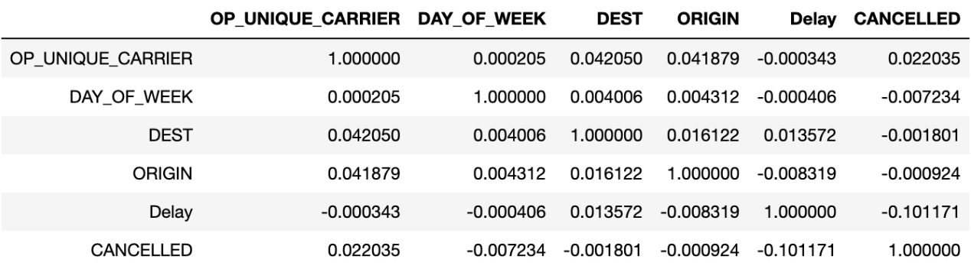
Correlation Analysis:
After analyzing the three focus areas individually, we investigated their relationship with travel problems
This was done by calculating correlations between focus variables and “Delay” and “CANCELLED” variables
The correlation table above displayed the results of this analysis
Delayed Flight:
The flight destination variable had the strongest correlation (0.0135)
The airline variable had the weakest correlation (-.000343)
Cancelled Flight:
The airline variable was the most highly correlated (.022035)
The flight origin variable was the weakest correlated (-0.000924)

Slide 11
Conclusions
Arrivals airport are more likely to have delays if there is a delay on departure airports.
EWR airports has the highest delayed rate in 2019. For the travellers who fly from or to this airport should plan ahead to accommodate the high chances of flight delayed.
The peak months of delayed flights are February, June and December.
Travelers should avoid Peninsula Airways (KS) and Commuteair (C5) because of their high delay risk
To avoid flight delays travelers should focus on destination
To avoid flight cancellation travelers should focus on airline selection
Weekday flights are more likely to be cancelled than weekend flights

Slide 12
References
Bobbitt, Z. (2022, March 15).Pandas: How to Create Bar Plot from GroupBy. Statology. Retrieved October 15, 2022, from https://www.statology.org/pandas-groupby-bar-plot/
Creating a new column based on other columns in pandas DataFrame. (n.d.). Retrieved October 15, 2022, from https://www.skytowner.com/explore/creating_a_new_column_based_on_other_columns_in_pandas
Sklearn.preprocessing.LabelEncoder. scikit. (n.d.). Retrieved October 22, 2022, from https://scikit-learn.org/stable/modules/generated/sklearn.preprocessing.LabelEncoder.html
How to explode a pie chart using Matplotlib in Python. (n.d.). Educative: Interactive Courses for Software Developers. Retrieved October 22, 2022, from https://www.educative.io/answers/how-to-explode-a-pie-chart-using-matplotlib-in-python

